Slide 1
Chapter 7 Single-Dimensional Arrays

Slide 2
Searching Arrays
Searching is the process of looking for a specific element in an array; for example, discovering whether a certain score is included in a list of scores. Searching is a common task in computer programming. There are many algorithms and data structures devoted to searching. In this section, two commonly used approaches are discussed, linear search and binary search.

Slide 3
From Idea to Solution
/** The method for finding a key in the list */
public static int linearSearch(int[] list, int key) {
for (int i = 0; i < list.length; i++)
if (key == list[i])
return i;
return -1;
}
Trace the method
int[] list = {1, 4, 4, 2, 5, -3, 6, 2};
int i = linearSearch(list, 4); // returns 1
int j = linearSearch(list, -4); // returns -1
int k = linearSearch(list, -3); // returns 5

Slide 4
Binary Search
For binary search to work, the elements in the array must already be ordered. Without loss of generality, assume that the array is in ascending order.
e.g., 2 4 7 10 11 45 50 59 60 66 69 70 79
The binary search first compares the key with the element in the middle of the array.

Slide 5
Binary Search, cont.
Consider the following three cases:
If the key is less than the middle element, you only need to search the key in the first half of the array.
If the key is equal to the middle element, the search ends with a match.
If the key is greater than the middle element, you only need to search the key in the second half of the array.

Slide 6
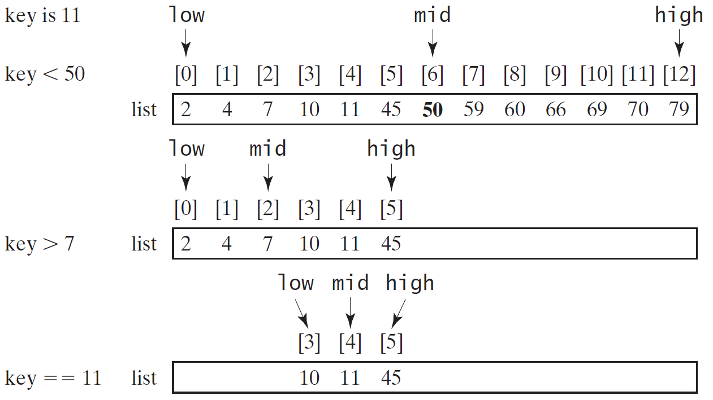
Binary Search, cont.

Slide 7
Binary Search, cont.

Slide 8
Binary Search, cont.
The binarySearch method returns the index of the element in the list that matches the search key if it is contained in the list. Otherwise, it returns
-insertion point - 1.
The insertion point is the point at which the key would be inserted into the list.

Slide 9
From Idea to Soluton
/** Use binary search to find the key in the list */
public static int binarySearch(int[] list, int key) {
int low = 0;
int high = list.length - 1;
while (high >= low) {
int mid = (low + high) / 2;
if (key < list[mid])
high = mid - 1;
else if (key == list[mid])
return mid;
else
low = mid + 1;
}
return -1 - low;
}

Slide 10
The Arrays.binarySearch Method
Since binary search is frequently used in programming, Java provides several overloaded binarySearch methods for searching a key in an array of int, double, char, short, long, and float in the java.util.Arrays class. For example, the following code searches the keys in an array of numbers and an array of characters.
int[] list = {2, 4, 7, 10, 11, 45, 50, 59, 60, 66, 69, 70, 79};
System.out.println("Index is " +
java.util.Arrays.binarySearch(list, 11));
char[] chars = {'a', 'c', 'g', 'x', 'y', 'z'};
System.out.println("Index is " +
java.util.Arrays.binarySearch(chars, 't'));
For the binarySearch method to work, the array must be pre-sorted in increasing order.
Return is 4
Return is –4 (insertion point is 3, so return is -3-1)

